Slide 1


INTERNSHIP
REPORT
BOREDOM LLP TECHNOLOGIES
INTERNSHIP DOMAIN: MVP TO AI-POWERED APPS: FOR THE MODERN WEB BUILDERS
PROJECT TITLE: ECOAI: SMART CARBON TRACKER & PERSONAL SUSTAINABILITY COACH
PRESENTED BY: NAGARAJ M

Slide 2

CompanyOverview
Company Name: Boredom LLP Technologies
Location: Hyderabad, Telangana, India
Domain: Web & AI Solutions, Full-Stack Development, and Cloud Deployments
Vision:To empower developers to build innovative, scalable, and AI-driven web applications
Focus Areas: Next.js based full-stack applications
Cloud and API integrations
AI-assisted platforms for productivity and sustainability

Slide 3
Abstract
Project Title: EcoAI: Smart Carbon Tracker & Personal Sustainability Coach
Description: EcoAI is an AI-powered sustainability tracking platform that helps users monitor their carbon footprint and receive personalized eco-friendly suggestions.
The system integrates Next.js, Firebase, Vercel, and OpenAI API to deliver real-time insights and sustainability recommendations.

Slide 4
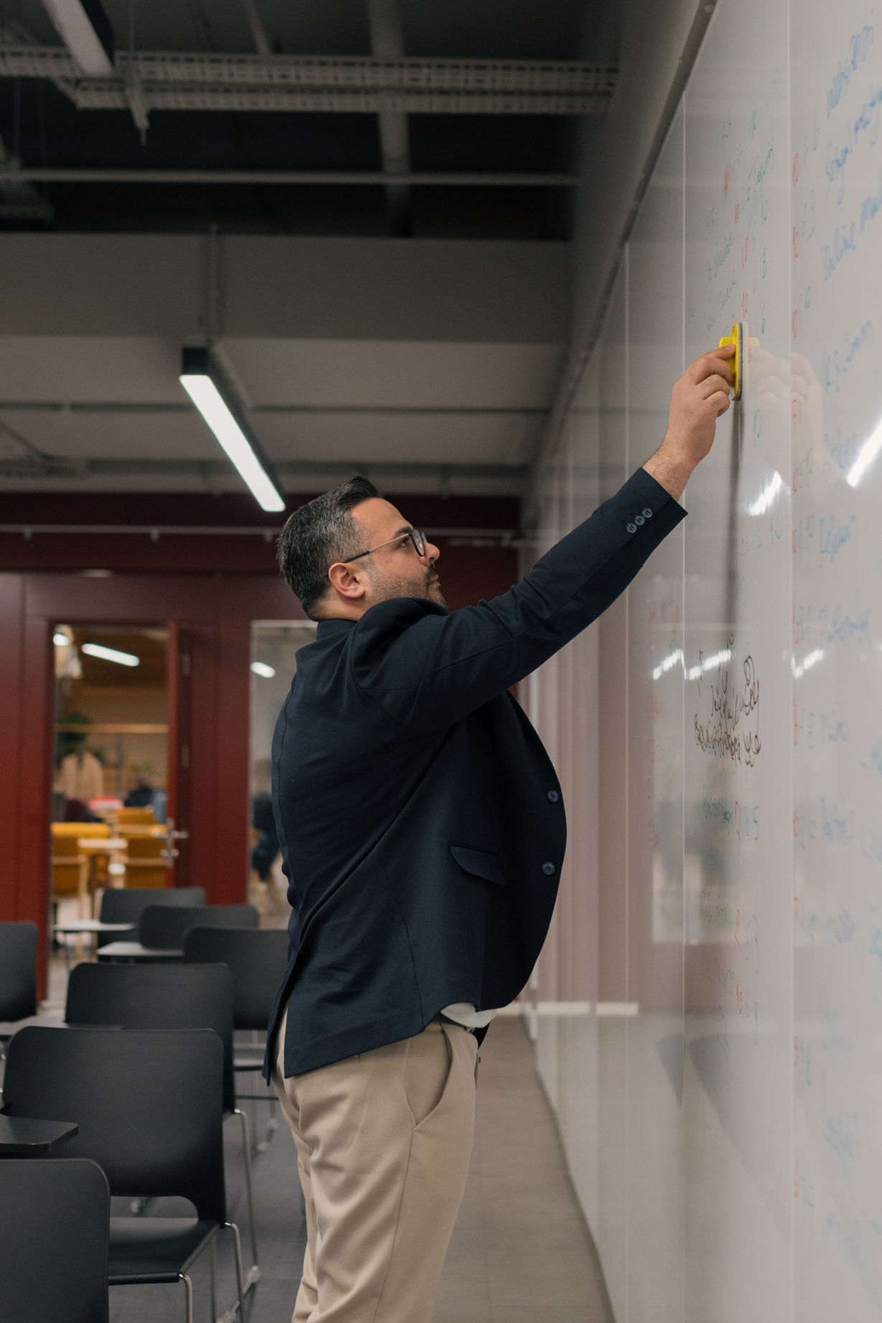
Objectives
To build a user-centric platform promoting eco-conscious living.
To integrate AI for generating intelligent sustainability suggestions.
To enable data storage and analytics through Firebase and Vercel.
To design a responsive and interactive web application using Next.js.
To deploy a scalable MVP demonstrating AI–Web technology synergy.

Slide 5



Tools & Technologies
Frontend-Next.js 15.3, Tailwind CSS
Backend-Next.js API Routes (route.ts)
Database-Firebase Firestore
Storage-Firebase Storage
AI Integration-OpenAI API
Analytics & Deployment-Vercel Analytics
Version Control-GitHub

Slide 6


Modules Implemented
Module 1: Landing Page Design & GitHub Deployment
Module 2: Next.js Code & Vercel Deployment
Module 3: UI Components – Banner, Footer, Avatar, EcoSuggestions
Module 4: MVP Design and Backend API Integration
Module 5: Storage Services & Analytics – Firebase and Vercel

Slide 7
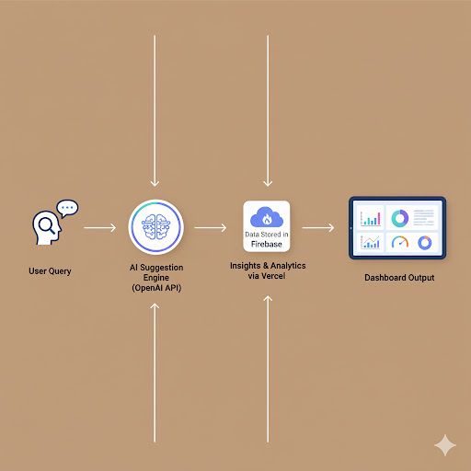
Project Workflow

Slide 8
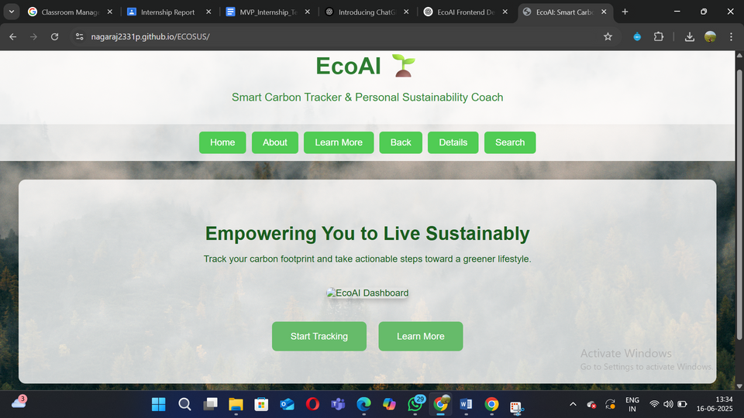
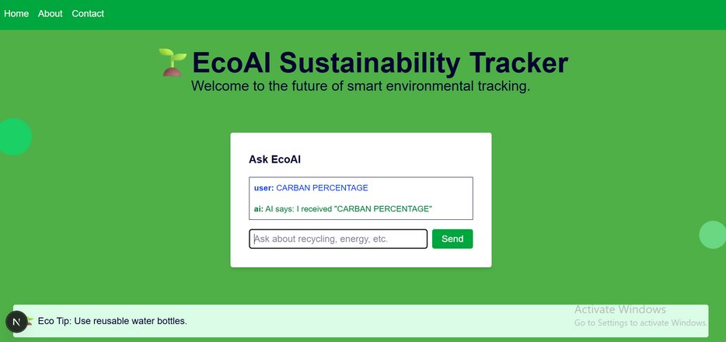
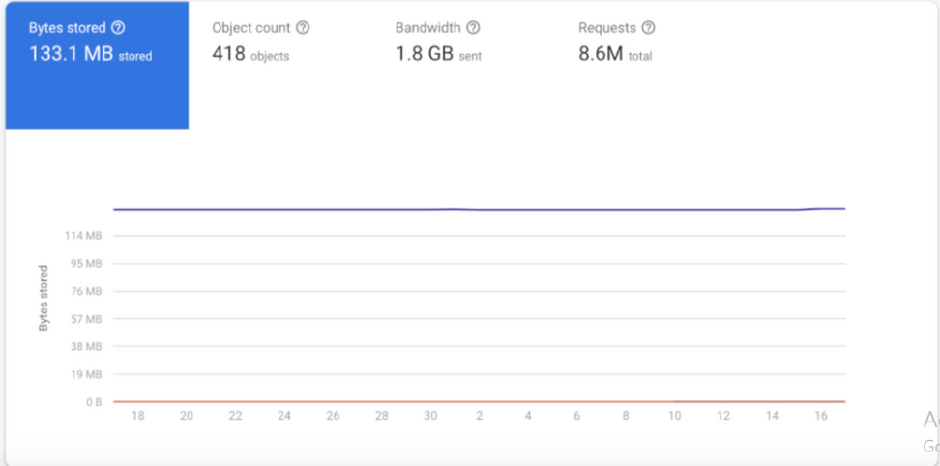
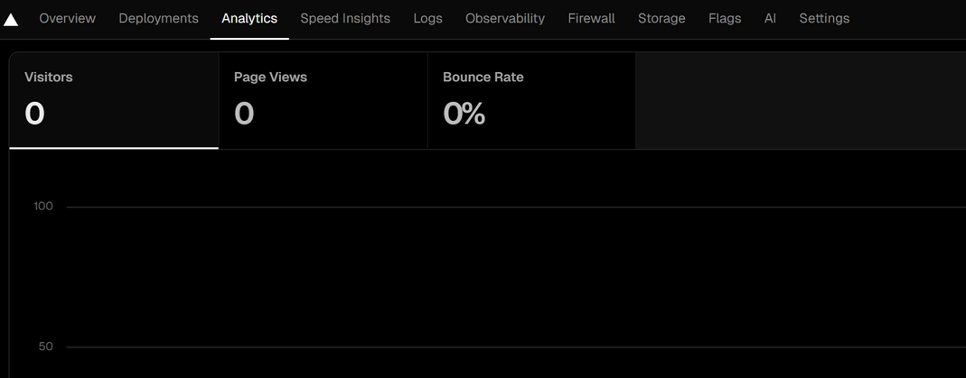
OutCome
Landing Page (EcoAI Branding)
AI Suggestion Chat Interface
Firebase Database Snapshot
Analytics Dashboard (Vercel)

Slide 9

Learnings&
Experience
Gained hands-on experience in Next.js full-stack development.
Understood API integration and AI model implementation.
Learned Firebase services (Storage, Firestore) and deployment on Vercel.
Improved knowledge in GitHub version control and CI/CD pipelines.
Strengthened problem-solving and design thinking skills.

Slide 10
Conclusion
The EcoAI project successfully combines AI intelligence with sustainability awareness.
Through this internship, I developed strong expertise in modern web development frameworks, cloud-based deployment, and AI-powered application design.
This experience has enhanced my technical proficiency and inspired me to continue building innovative, scalable, and sustainable web solutions.

